Slide 1
Tools of the Trade
Or
Thriving not just surviving in a project
(I’m Laurie Cooper)
Digital project teams can be pressured environments.
Let us help you anticipate some of the things which happen to cause this, and give you some tools to combat them.

Slide 2

DigitalLabs@MMU
We belong to MMU
We live in the Shed
We build tech
We write software

Slide 3
DigitalLabs@MMU
We’re an Enterprise Unit
We model a small business
We try to stay afloat
We’re staffed by real developers
We share our experiences

Slide 4
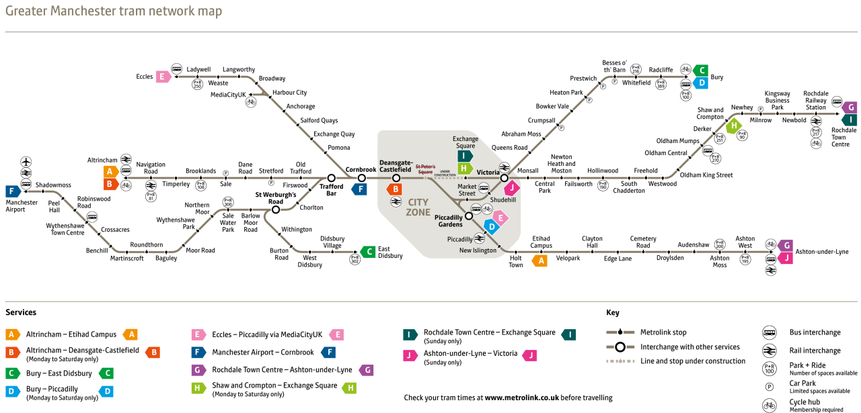
Today
how we got here; where we’re going
rise of the digital entrepreneur
small teams doing big things
personal tools
know yourself
support your team and be supported
digital tools
somebody had a great idea
be prepared
every project is different, but…
putting it together
sprints and tasks and stand-ups, oh my!
oh, the release!
if you got here…
Notes:
b

Slide 5

How we got here
Image credit: Tory Townsend

Slide 6
How we got here
The rise of the digital entrepreneur
Novelty Sells.
Notes:
b

Slide 7

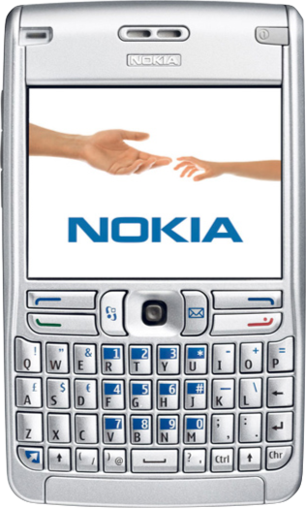
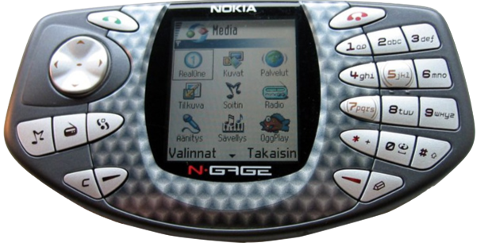
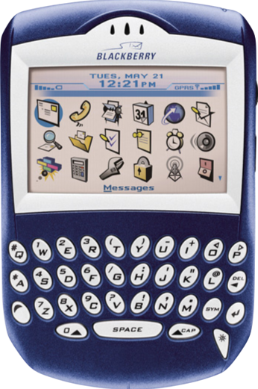
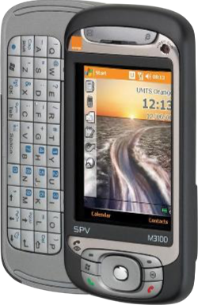
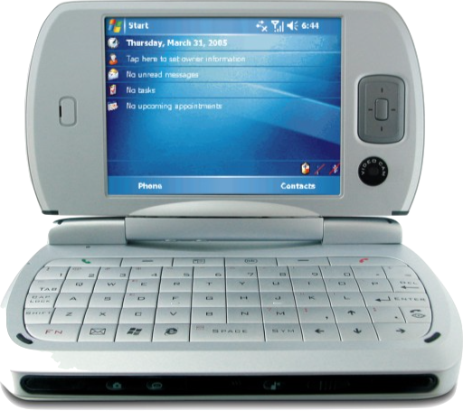
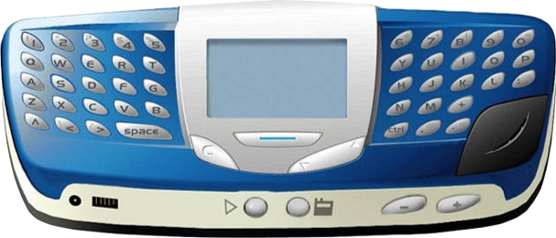
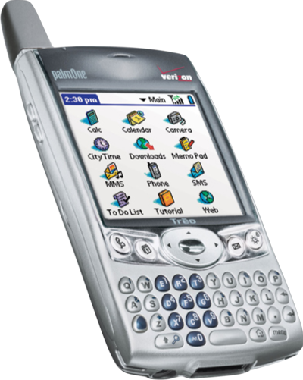
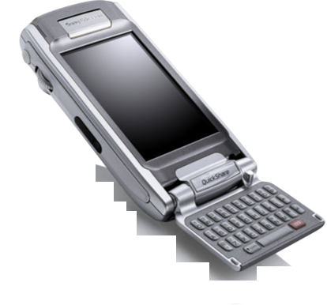
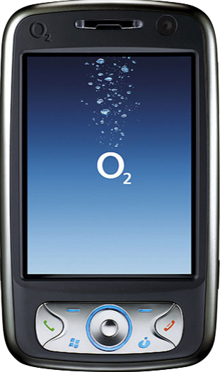
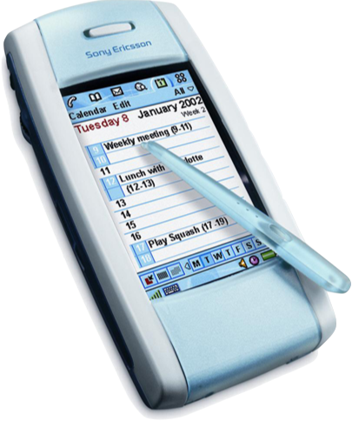
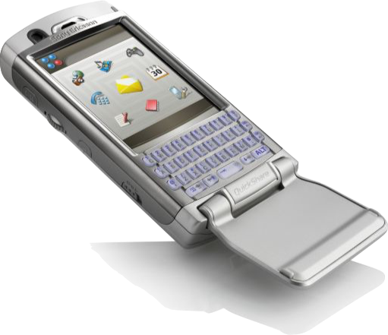
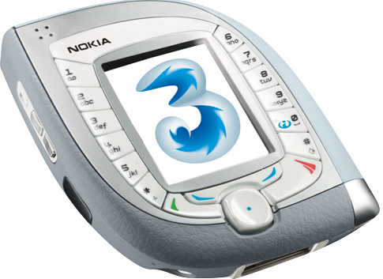
How we got here
The rise of the digital entrepreneur
There were Smartphones before the iPhone
2000
2007
Notes:
b

Slide 8
How we got here
The rise of the digital entrepreneur
Smartphone software: Code warriors only!
Languages: C / C++ or J2ME
The biggest smartphone manufacturer: Nokia
The biggest mobile OS: Symbian and Windows CE.
It wasn’t easy to write. Terrible tools. It certainly wasn’t easy to sell.
Notes:
b

Slide 9

How we got here
The rise of the digital entrepreneur
The iPhone arrives in 2007.
(Steve Jobs)
Notes:
b

Slide 10
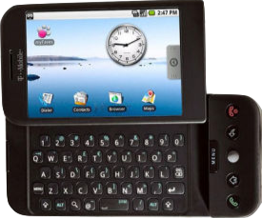
How we got here
The rise of the digital entrepreneur
The HTC Dream arrives in 2008.
Android Marketplace arrives the same year.
(Sergey Brin, Larry Page, Andy Rubin)
Notes:
b

Slide 11
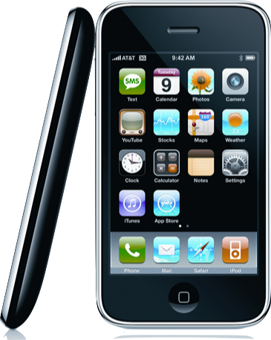
How we got here
The rise of the digital entrepreneur
no apps.
no 3G.
It didn’t get those for another year.
…oh, but when it did..
Notes:
b

Slide 12
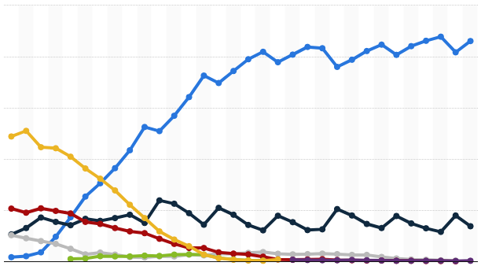
How we got here
The rise of the digital entrepreneur
2008:
Apple had iOS and an app store.
Google had Android and an app store.
2011:
We lost:
Symbian
Windows CE
J2ME
Sony Ericsson
Soon, Nokia was history, too.
Vendors' sales of mobile phone sales to end users worldwide from 2010 to 2015 (in million units), by quarter
Global mobile OS market share in sales to end users from 1st quarter 2009 to 1st quarter 2017
Notes:
b

Slide 13
How we got here
The rise of the digital entrepreneur
Google and Apple had different business drivers
Apple: “Buy our products!”
Google: “You’re our product!”
But both Apple and Google:
incentivised software innovation, through the App Store.
made it easy to write apps and sell them
increase the novelty of their product
spawned secondary industries and enabling technologies
Apps + Internet = Massive number of innovators
And here we are, 10 years later, still driven by novelty.
Notes:
b

Slide 14
How we got here
The rise of the digital entrepreneur
Good News
enabling technologies are now of a quality to be accessible to entrepreneurs with small resources
Bad News
It’s a gold rush
Meaning..?
Very high competition
High probability of ‘simultaneous discovery’
End-user expectations are very high – for ANY technological product
Money is unexpectedly hard to get - both investment and return
Project failure is very high
Notes:
b

Slide 15
How we got here
The rise of the digital entrepreneur
It doesn’t matter:
single entrepreneur
ambitious small tech business
big tech global player
…all are subject to the same market pressures
News Flash: Windows 10 Mobile iced
Notes:
b

Slide 16
How we got here
The rise of the digital entrepreneur
the competition in the industry means
everyone is striving to get their idea out there
before anyone else
before they run out of cash
These pressures can be passed on to you as a developer
Notes:
b

Slide 17
How we got here
The rise of the digital entrepreneur
Coming Next: Tools to help
Personal Tools
Digital Tools
Notes:
b

Slide 18
Personal Tools
Image credit: Tory Townsend

Slide 19
Personal Tools
Small teams, doing big things
Good practices:
Recognise smart teams have adapted to this marketplace
You can prepare yourself for working in it
Notes:
b

Slide 20
Personal Tools
Small teams, doing big things
Good practices:
Lean
Agile
Notes:
b

Slide 21
Personal Tools
Small teams, doing big things
Lean
Business practice (Lean Start-up)
Main proponent is Eric Reis - roots go back to Henry Ford
Philosophy: Focus on your product – eliminate wasteful practices
Clickbait for you: obligatory wikipedia entry
Notes:
b

Slide 22
Personal Tools
Small teams, doing big things
Lean
Who is your customer?
What do they want from your product?
Build a minimum viable product as soon as possible
Test it out on your customer
Do it again
Clickbait for you: obligatory wikipedia entry
Notes:
b

Slide 23
Personal Tools
Small teams, doing big things
Agile
Development philosophy for software teams
12 point ‘Agile Manifesto’
Philosophy: embrace change
Clickbait for you: obligatory wikipedia entry
Notes:
b

Slide 24
Personal Tools
Small teams, doing big things
Agile
Deliver working software often
Stay motivated
Keep it simple
Clickbait for you: obligatory wikipedia entry
Notes:
b

Slide 25
Personal Tools
Small teams, doing big things
Agile + Lean = Focussed, Short iterations, Feedback
Clickbait for you: obligatory wikipedia entry
Notes:
b

Slide 26
Personal Tools
Small teams, doing big things
Agile + Lean = Motivated teams learning quickly
Clickbait for you: obligatory wikipedia entry
Notes:
b

Slide 27
Personal Tools
Small teams, doing big things
Agile + Lean = Delivery focussed
Clickbait for you: obligatory wikipedia entry
Notes:
b

Slide 28
Personal Tools
Small teams, doing big things
You and your team need to
Communicate
Accepting Change
Stay motivated
Learn Quickly
…and you only just met! Is this possible?!
Notes:
b

Slide 29
Personal Tools
Small teams, doing big things
SHOW
AND
TELL!
Notes:
b

Slide 30
Personal Tools
Small teams, doing big things
Coming around:
University And Me – cross-platform AR app for schools. 11-15 year-olds.
Customer: Greater Manchester Higher
Development Time: 9 months:
Team Size: 1 – 5 over the course of the project
Appatella – cross platform exercise app + multiple web-services for patients, clinicians and researchers. Customer: Arthritis Research UK
Development Time: 9 months
Team Size: 1 – 2 over the course of the project
Both projects were run concurrently
Notes:
b

Slide 31
Personal Tools
Know yourself
ASK YOURSELF
Notes:
b

Slide 32
Personal Tools
Know yourself
www.16personalities.com
Red Button: Take the Test
It asks some searching questions
When you’re done:
Take a look at what the test says about your ‘personality trait’
What do you think?
You have 12 minutes!
Notes:
b

Slide 33
Personal Tools
Know yourself
Before we go any further:
It’s not a label. People change.
It helps to think about yourself
(Think of it as an indication of your current state)
It helps to think about other people
Notes:
b

Slide 34
Personal Tools
support your team and be supported
Analysts | Diplomats | Sentinels | Explorers
INTJ | INFJ | ISTJ | ISTP
INTP | INFP | ISFJ | ISFP
ENTJ | ENFJ | ESTJ | ESTP
ENTP | ENFP | ESFJ | ESFP

Slide 35
Personal Tools
support your team and be supported
Feel Like Sharing?
We’ll look at your potential strengths and weaknesses.
My Team:
INTJ (Alice)
INFJ (Me)
ENTP (Jim)
Notes:
b

Slide 36
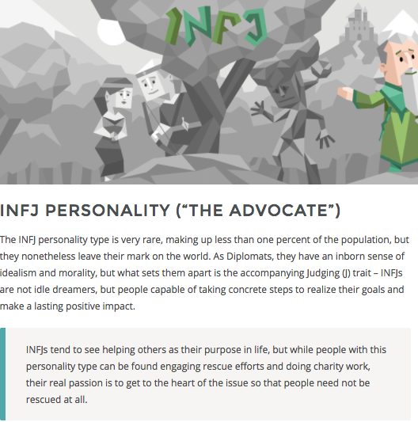
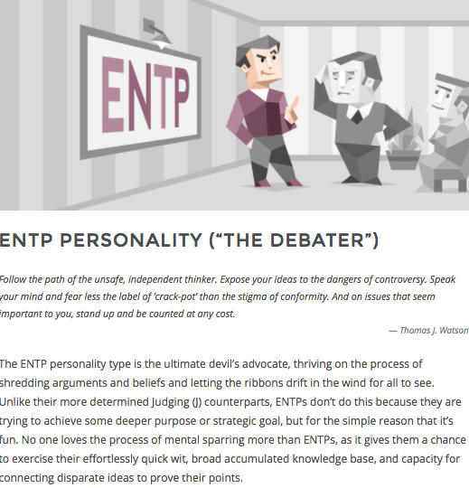
Personal Tools
support your team and be supported
Me
Jim
Notes:
b

Slide 37
Personal Tools
support your team and be supported
Me
Jim
Strengths:
Creative
Insightful
Inspiring and convincing
Determined and passionate
Altruistic
Strengths:
Knowledgeable
Quick thinkers
Original
Excellent Brainstormers
Charismatic
Energetic
Notes:
b

Slide 38
Personal Tools
support your team and be supported
Me
Jim
Weaknesses:
Sensitive (to criticism)
Extremely private
Perfectionistic
Always needs to have a cause
Can burn out easily
Weaknesses:
Argumentative
Insensitive
Intolerant
Can find it difficult to focus
Dislikes Practical Matters
Notes:
b

Slide 39
Personal Tools
support your team and be supported
People are not like you.
Tolerance and understanding lead to good teams ☺
Notes:
b

Slide 40
Personal Tools
support your team and be supported
Outside your team
Dealing with other specialists
(… like your client)

Slide 41
Personal Tools
support your team and be supported
The Dunning-Kruger effect:
Non-specialists tend to over-estimate their ability in another’s specialism
Leads to unrealistic expectations from business/client (“can’t you just…”)
Specialists tend to over estimate non-specialist’s ability in their specialism
Leads to disempowerment (“oh, come on; the off-side rule is easy to understand!”)

Slide 42
Personal Tools
support your team and be supported
Be careful in your discussions with non-specialists
Remember that they are specialists in their field, too ☺

Slide 43
Digital Tooling
Image credit: Tory Townsend

Slide 44
Digital Tools
somebody had a great idea
“Simplicity--the art of maximizing the amount of work not done--is essential.”
From: Principles behind the Agile Manifesto

Slide 45
Digital Tools
somebody had a great idea
“Simplicity--the art of maximizing the amount of work not done--is essential.”
Quick tour of labour-saving stuff, for:
Preparation
Documentation
Project Management
Design
Code
Test
Security
Deployment
Communication

Slide 46
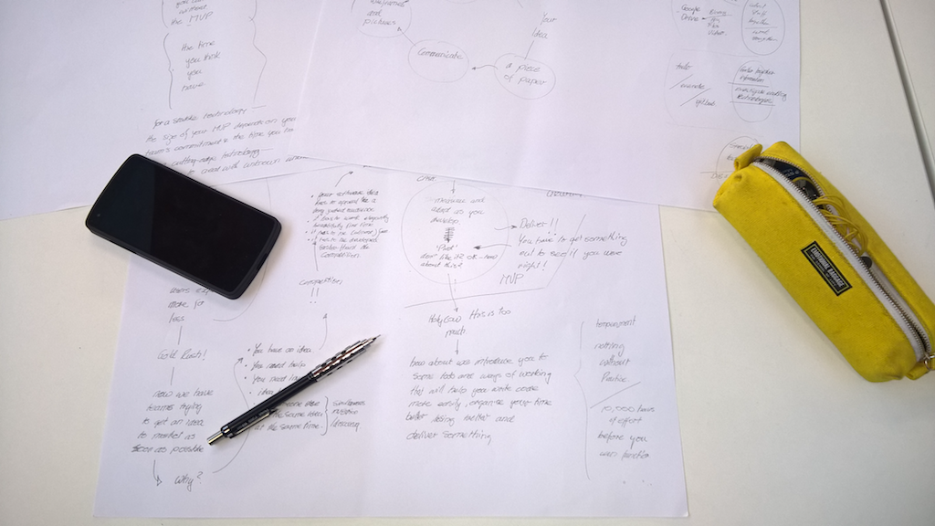
Digital Tools
somebody had a great idea
“Simplicity--the art of maximizing the amount of work not done--is essential.”
Preparation
Solidify your ideas with pencil and paper
Or a white board
Bad ideas? Bin ‘em
Good ideas? Take a photo!

Slide 47

Digital Tools
somebody had a great idea
“Simplicity--the art of maximizing the amount of work not done--is essential.”
Documentation
Document it only if it’s essential:
Your own learning
A how-to
A status
A communication
Minimise your formatting
Use Markdown
Use a wiki
Image credit: Dustin Curtis

Slide 48

Digital Tools
somebody had a great idea
“Simplicity--the art of maximizing the amount of work not done--is essential.”
Project Management
We use Trello
Ridiculously easy to use
Lists of cards
Cards hold information (markdown, pictures, links, etc)
Clever plugin to help estimate effort: Scrum for Trello
Image credit: Caylakwiki

Slide 49

Digital Tooling
somebody had a great idea
“Simplicity--the art of maximizing the amount of work not done--is essential.”
Project Management
We use Github
Document repository
De-facto place for open source projects and example code
Multiple people working on many documents at the same time
Check-in, check-out documents
Merge other people’s changes
As easy as it can be
Image credit: GitHub

Slide 50

Digital Tools
somebody had a great idea
“Simplicity--the art of maximizing the amount of work not done--is essential.”
Project Management
We use Source Tree – as an easy Github UI
Image credit: Source Tree

Slide 51
Digital Tools
somebody had a great idea
“Simplicity--the art of maximizing the amount of work not done--is essential.”
Project Management
We use a whiteboard for a Gantt Chart
If we need to, we take a pic of the Gantt chart, and put it on a Trello board
Stop Press: Gantt Plugin for Trello
Image credit: GitHub

Slide 52

Digital Tools
somebody had a great idea
“Simplicity--the art of maximizing the amount of work not done--is essential.”
Identity
Every project we do has its own gmail address
All free accounts are then applied for using this identity
We can pass on the identity to our client when the project is complete
Get 5GB of storage too, for backing up releases
Image credit: Google Inc.

Slide 53

Digital Tooling
somebody had a great idea
“Simplicity--the art of maximizing the amount of work not done--is essential.”
Design
We use Pencil and Paper:
UML class, entity and state diagrams
We use Evolus Pencil for UI design and prototyping
Image credit: Evolus Pencil

Slide 54
Digital Tools
somebody had a great idea
“Simplicity--the art of maximizing the amount of work not done--is essential.”
Design
We formalise and version interfaces
We create RESTful micro services to deliver remote resources
We use RESTlet Studio to do this
Why?
Interfacing allows us to ‘stub’ functionality on the server, and develop client and server at the same time.
RESTlet Studio is easy to use and FREE
Image credit: Evolus Pencil

Slide 55
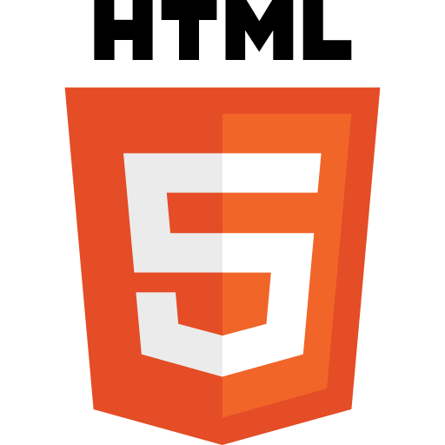
Digital Tools
somebody had a great idea
“Simplicity--the art of maximizing the amount of work not done--is essential.”
Code
We develop cross-platform mobile apps, using Ionic/Cordova - Javascript
We develop server applications using Swagger on nodejs – Javascript
We develop web applications using nodejs, Express, Pug (Jade)– Javascript
Why? Because we can leverage the same language, same concepts across the board, minimising our learning-curve
Image credit: W3C

Slide 56

Digital Tools
somebody had a great idea
“Simplicity--the art of maximizing the amount of work not done--is essential.”
Code
We use MS Visual Studio Code for an IDE
(With Android Studio and Xcode)
Why? It’s easy to use.
It has a really good, well supported plugin architecture. It knows how to cope with Markdown, JavaScript, C/C++/C#, Java, Python, SQL, JSON, XML.
We use Android Studio and Xcode to manage the build process of our cross platform apps.
If you want to support iOS with a cross-platform app, you NEED an Apple Mac
Image credit: Microsoft Corp.

Slide 57
Digital Tools
somebody had a great idea
“Simplicity--the art of maximizing the amount of work not done--is essential.”
Test
We unit test anything which sits behind an API
Unit Test frameworks integrate directly into source code.
Why?
As code gets more complex, it’s dependencies increase. A minor change can have an unintended effect.
Unit tests can be run on a build after alterations, and go through all sensitive scenarios which could cause a failure.
(You *will* ‘break the build’. It’s not a biggy.)

Slide 58
Digital Tools
somebody had a great idea
“Simplicity--the art of maximizing the amount of work not done--is essential.”
Test
There are automated test frameworks which test interactions via the UI
We don’t use them
We probably should
Very useful in continuous deployment
System takes a while to set up
Inappropriate for small projects?

Slide 59
Digital Tools
somebody had a great idea
“Simplicity--the art of maximizing the amount of work not done--is essential.”
Security
If you deal with any kind of user data, the you need to be aware of:
The Information Commissioner’s Office (ICO)
The Data Protection Act
Securing websites and databases is tricky.
It is an arms race.
Use Platforms As A Service to delegate:
Complex configuration
User Authentication

Slide 60

Digital Tools
somebody had a great idea
“Simplicity--the art of maximizing the amount of work not done--is essential.”
Security
We use Heroku as our easy-to-use service provider.
Why?
Much of the configuration previously seen with webservers is hidden.
Lets us concentrate on the good stuff
Provides us with a Postgres database
‘Free Tier’
Graduated Pricing

Slide 61
Digital Tooling
somebody had a great idea
“Simplicity--the art of maximizing the amount of work not done--is essential.”
Security
We use Heroku as our easy-to-use service provider.
Why?
Much of the configuration previously seen with webservers is hidden.
Lets us concentrate on the good stuff
‘Free Tier’
Graduated Pricing
Image credit: Heroku

Slide 62
Digital Tools
somebody had a great idea
“Simplicity--the art of maximizing the amount of work not done--is essential.”
Security
We use Auth0 as our easy-to-use authentication provider.
Why?
We can delegate all user accounts to Auth0
They provide a robust method by which we can authenticate users.
Lets us concentrate on the good stuff
‘Free Tier’
Graduated Pricing

Slide 63
Digital Tools
somebody had a great idea
“Simplicity--the art of maximizing the amount of work not done--is essential.”
Deployment
We use Heroku as our easy-to-use service provider.
Why?
We connect our Github repository to Heroku
Heroku will package and deploy our web-application on-demand
Image credit: Heroku

Slide 64
Digital Tools
somebody had a great idea
“Simplicity--the art of maximizing the amount of work not done--is essential.”
Communication
We work in the same place.
We don’t use Slack, Messenger, Signal, What’s App, snail-mail or paper aeroplane.
Why?
We live close enough, and anything else is a faff.
If we lived far away, that would be different.
We probably wouldn’t be doing this.

Slide 65
Digital Tooling
somebody had a great idea
“Simplicity--the art of maximizing the amount of work not done--is essential.”
Summary?
Tools are there to make you more productive. Try a tool out; if you don’t feel the love within 10 minutes, try another.
(…if you get through a whole bunch of tools like that, it may be time to relax that expectation)

Slide 66
Putting it all
together
Image credit: Tory Townsend

Slide 67
Putting it all together
be prepared
“Reports that say that something hasn't happened are always interesting to me, because as we know, there are known knowns; there are things we know we know.
We also know there are known unknowns; that is to say we know there are some things we do not know.
But there are also unknown unknowns – the ones we don't know we don't know.
And if one looks throughout the history of our country and other free countries, it is the latter category that tend to be the difficult ones”
From: Donald Rummsfeld, United States Secretary of Defense: 2002

Slide 68
Putting it all together
be prepared
“no plan of operations extends with any certainty beyond the first contact with the main hostile force.”
From: Helmuth von Moltke the Elder

Slide 69
Putting it all together
be prepared
“be prepared”
From: Robert Baden-Powell
He also said: “The most worth-while thing is to try to put happiness into the lives of others.”. Which was nice.

Slide 70
Putting it all together
be prepared
We present
A way in which to run a project which expects setback.
Based - on
Real-world experiences, stuff we’ve done and stuff you’ve seen here.

Slide 71
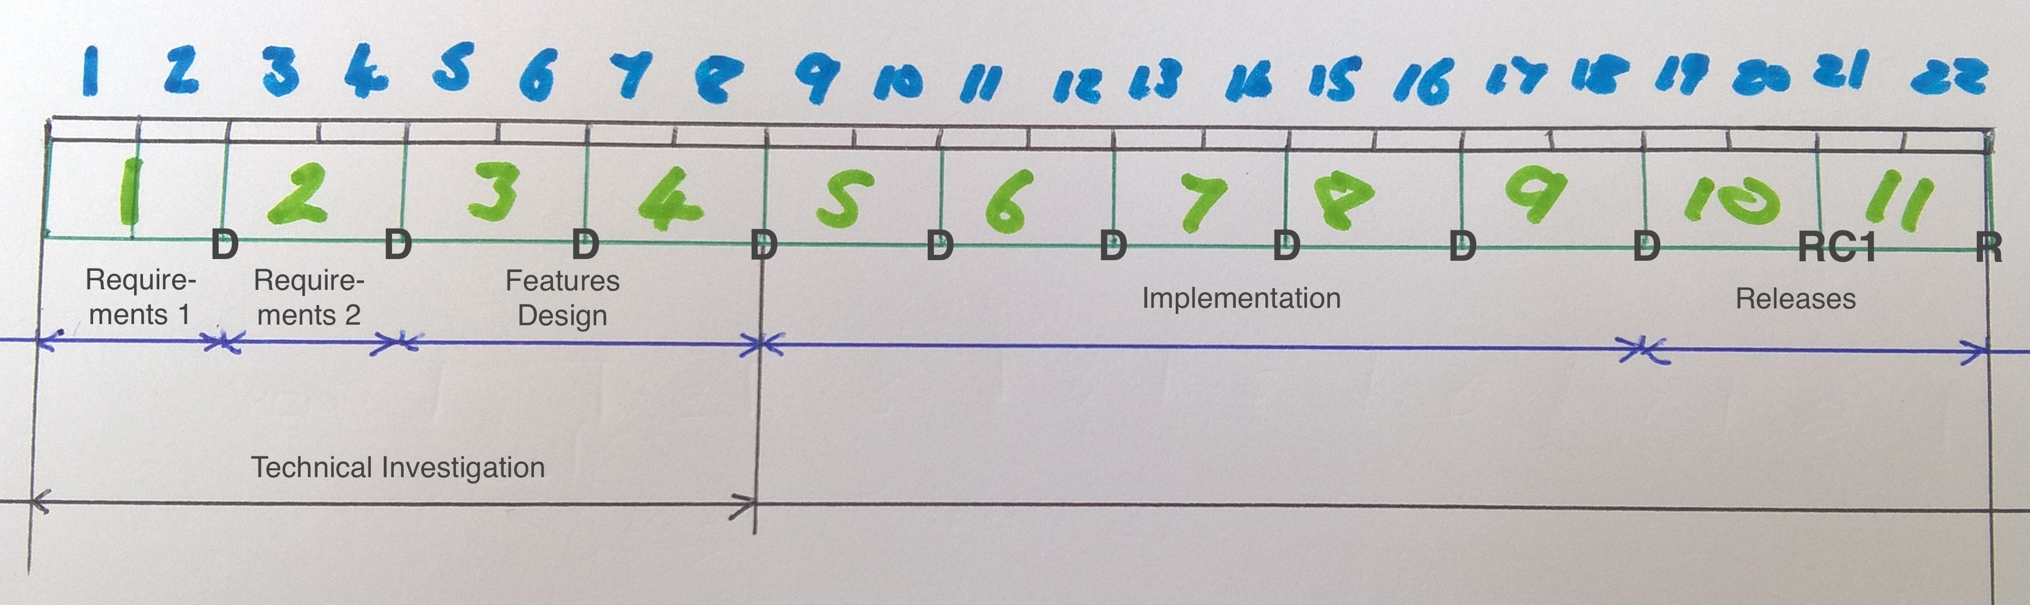
Putting it all together
every project is different, but…
Object: Produce an MVP from a client brief in 22 weeks
Phases:
Prep
Implementation
Release
Regular short sprints and deliveries

Slide 72
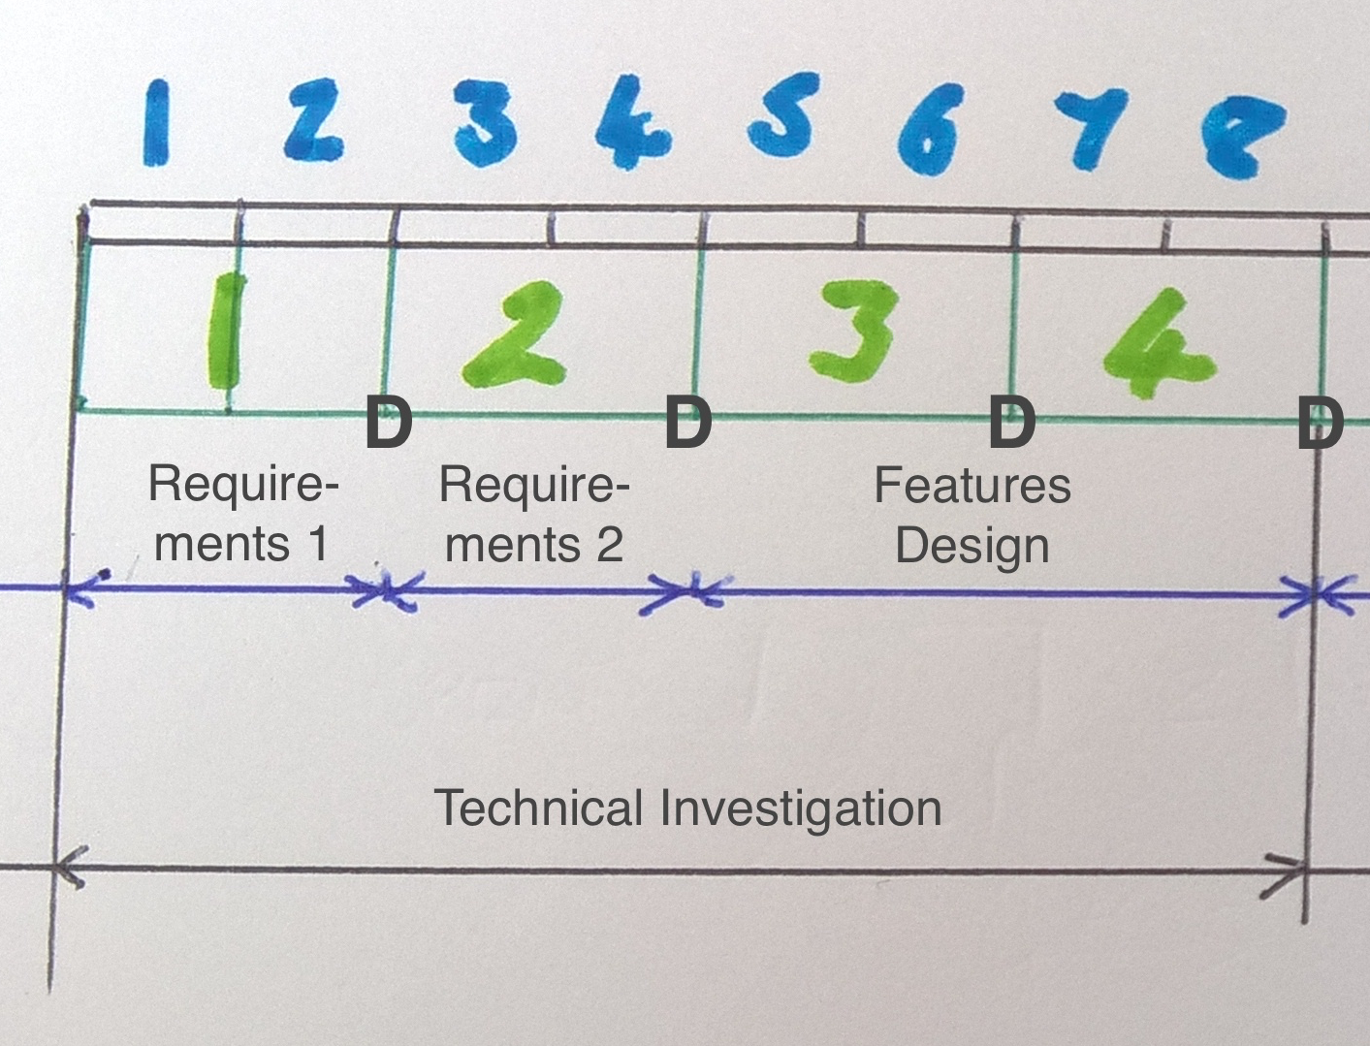
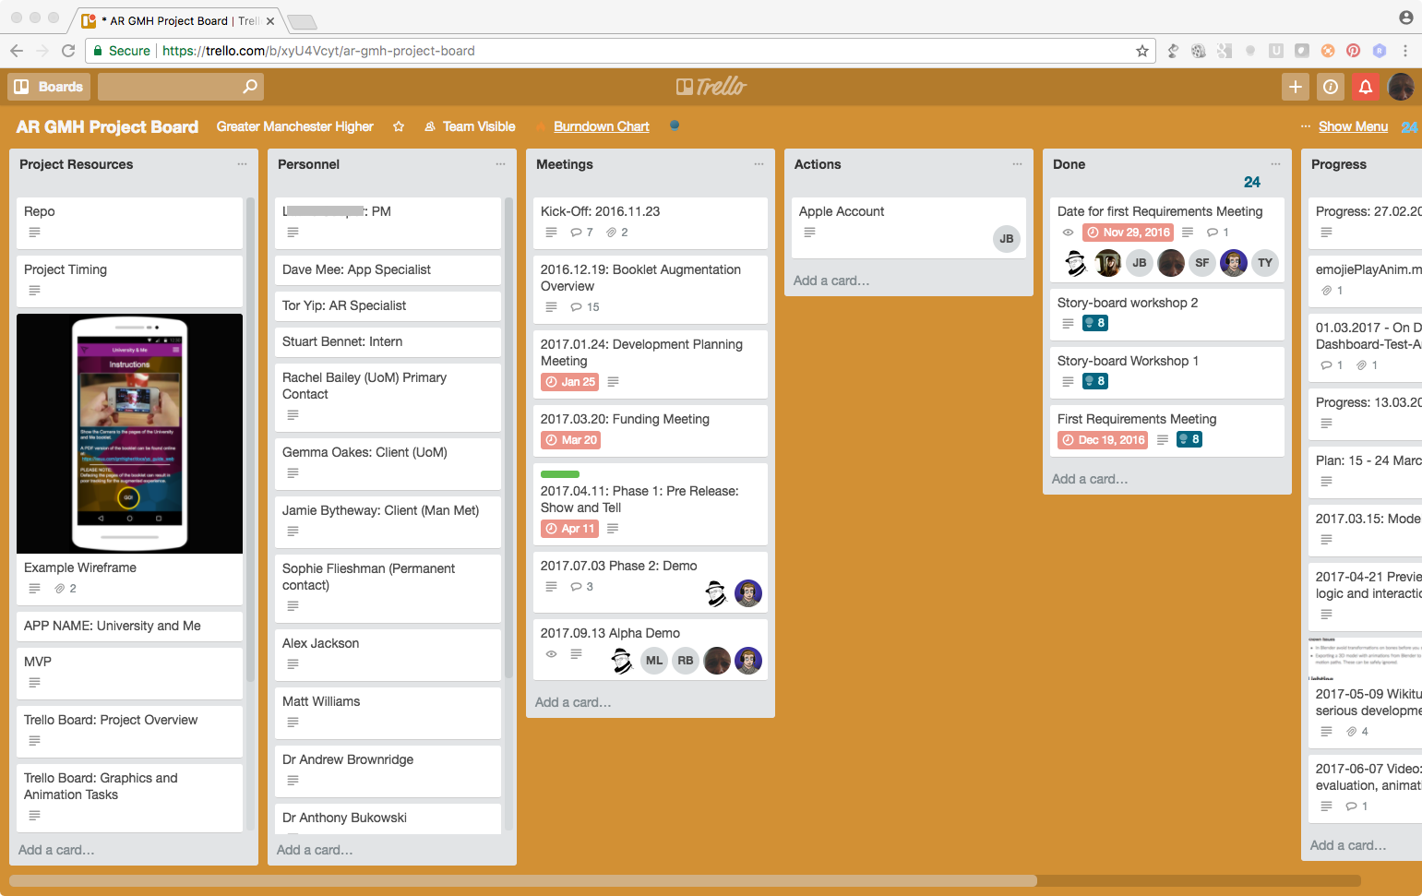
Putting it all together
every project is different, but…
Prep:
Client, stakeholder: The VIP
Project Manager: collate and communicate status
Technical Lead: collate and communicate technical vision
Trello: for easy-to-use project information

Slide 73
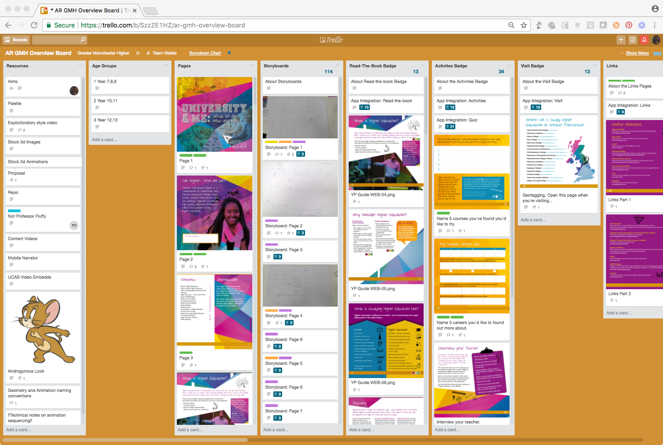
Putting it all together
every project is different, but…
Trello for requirements capture
Collaborative. Client and team can see everything

Slide 74
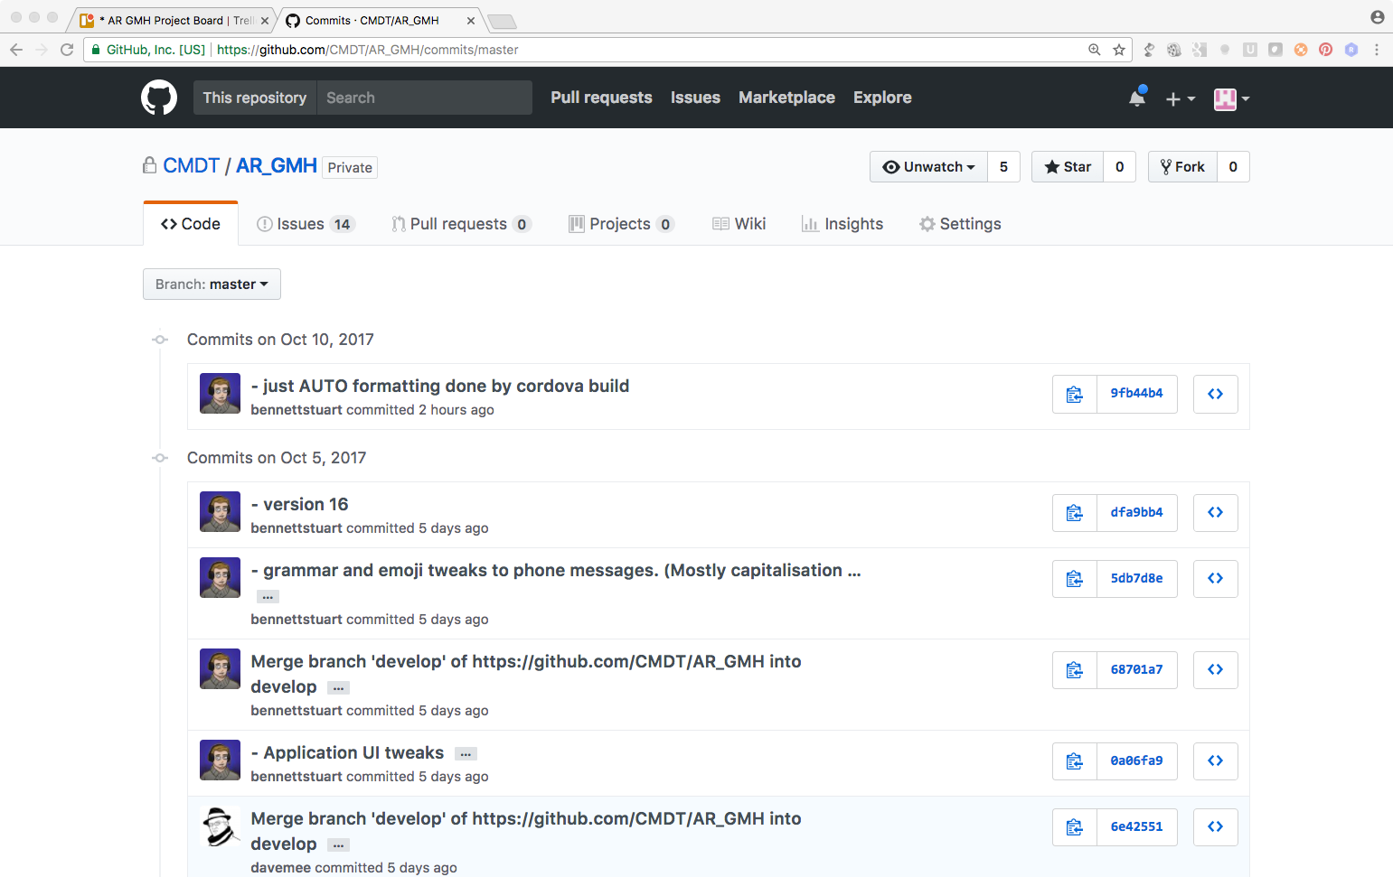
Putting it all together
every project is different, but…
Github for any docs
Github for code
Too complex for client to use
Make docs into PDF, and post on Trello board

Slide 75
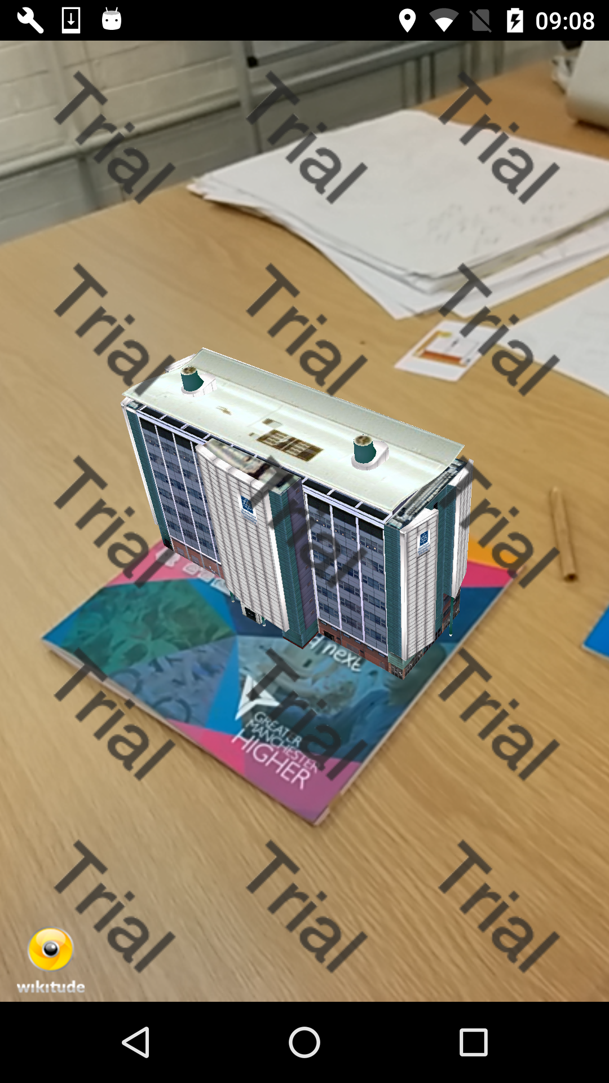
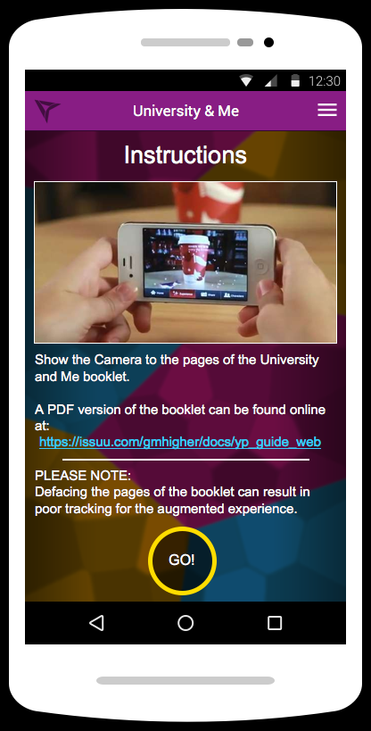
Putting it all together
every project is different, but…
Requirements capture and initial design process in parallel with a technical investigation
All code gets checked-in as evidence

Slide 76
Putting it all together
every project is different, but…
Delivery 1: First MVP feature set
Feedback
Delivery 2: Refined MVP feature set
Feedback
Delivery 3: First MVP design and estimate
Feedback
Delivery 4:
Feedback and sign off
Ready for Implementation
Features -> Design -> Component break-down -> Tasks -> Estimate

Slide 77
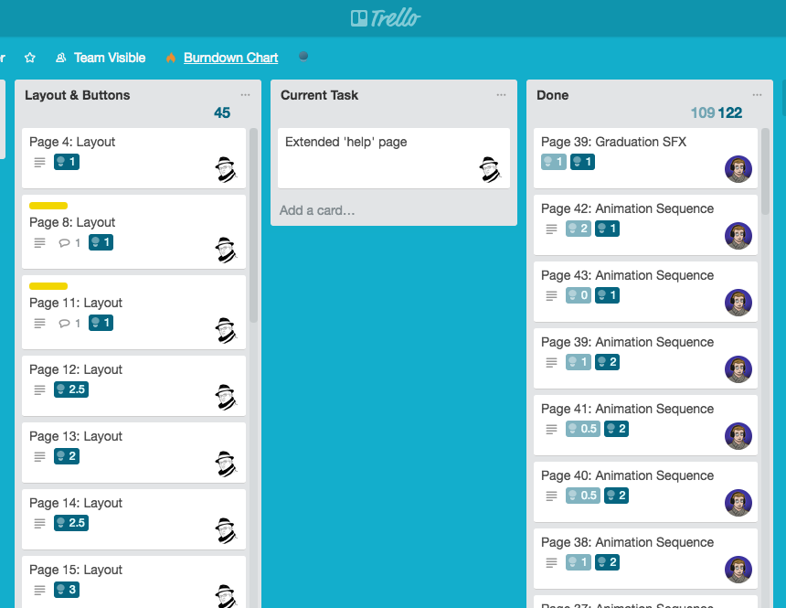
Putting it all together
every project is different, but…
Features -> Design -> Component break-down -> Tasks -> Estimate

Slide 78
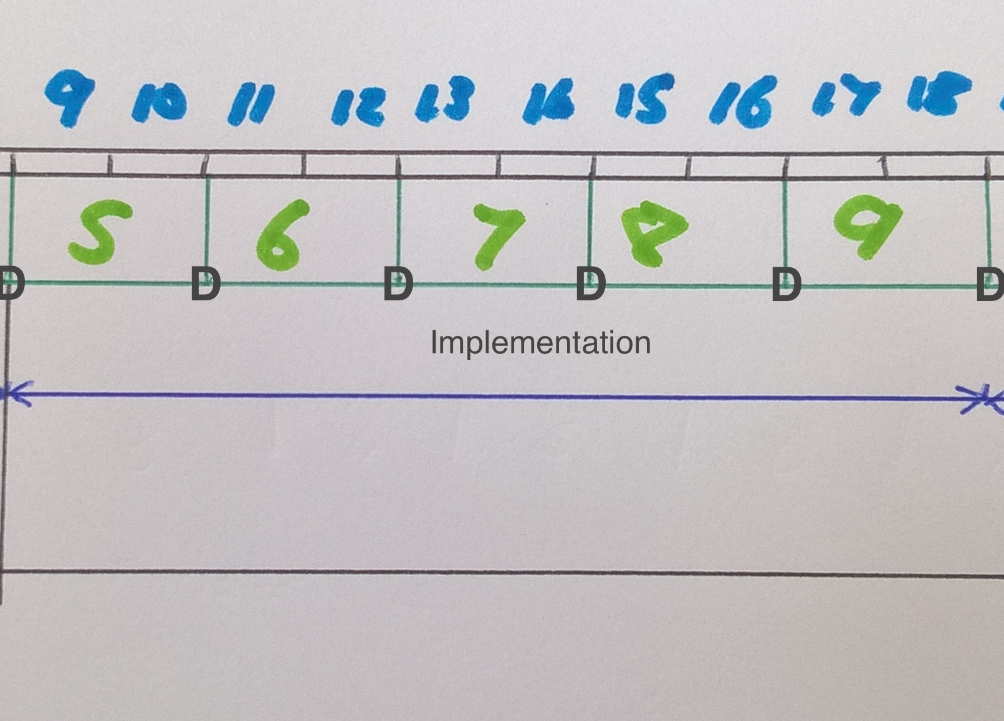
Putting it all together
sprints and tasks and stand-ups, oh my!
Implementation: Begin each day with a short meeting (called a stand-up)
Each team member states:
what they did yesterday
what they plan to do today
and any problems
Tasks are allocated according to suitability at the stand-up

Slide 79
Putting it all together
sprints and tasks and stand-ups, oh my!
Unknown Unknowns
Begin each day with a short meeting (called a stand-up)
Each team member states:
what they did yesterday
what they plan to do today
and any problems
Tasks are allocated according to suitability at the stand-up

Slide 80
Putting it all together
sprints and tasks and stand-ups, oh my!
End each Sprint with a delivery
Push uncompleted tasks into the next sprint

Slide 81
Putting it all together
sprints and tasks and stand-ups, oh my!
End final sprint with a feature freeze
Some features won’t make it
That’s OK.
No more new features: ditch Trello!

Slide 82
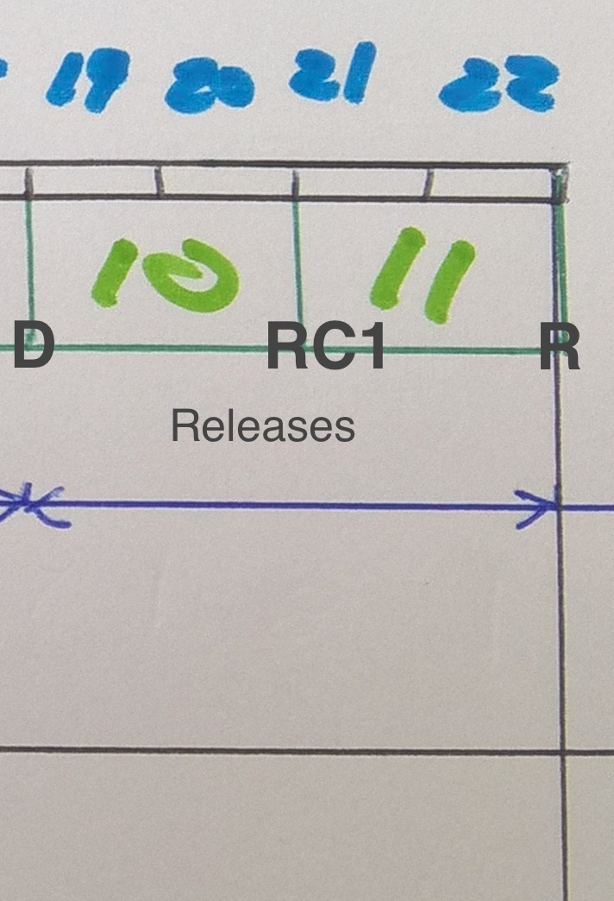
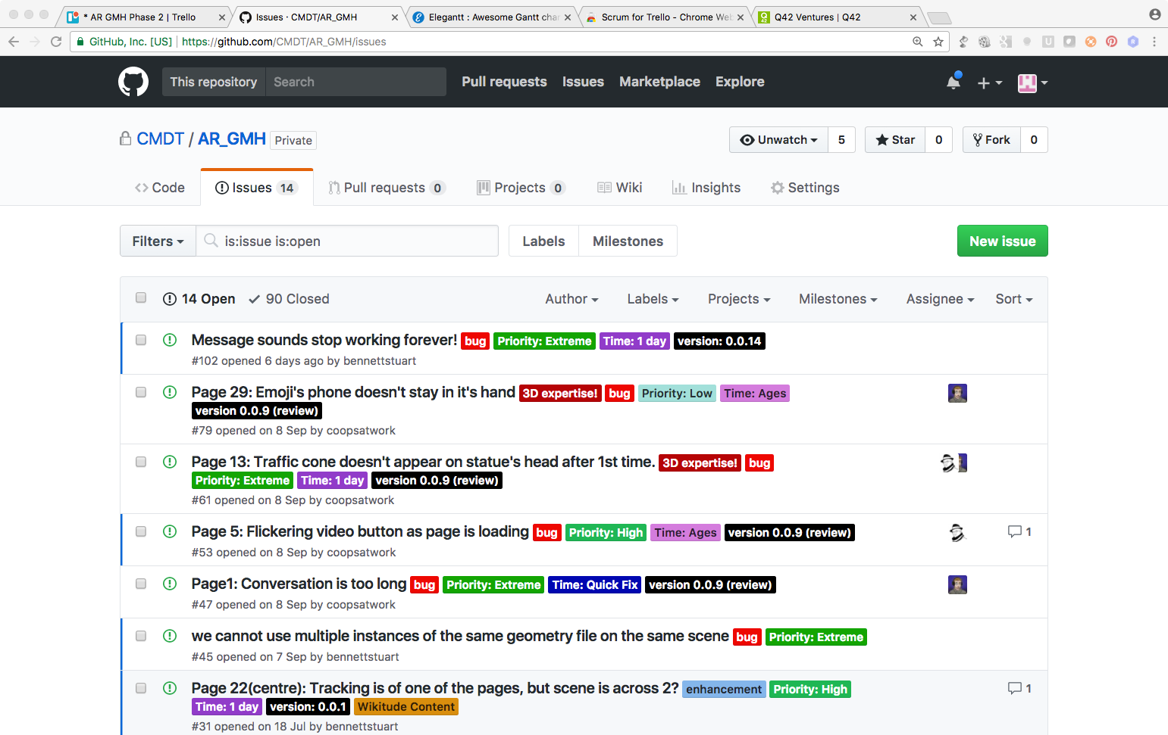
Putting it all together
Oh, the release…!
Release:
Use a ‘Release candidate’ to test your release in front of a friendly audience
Use an issues list (GitHub) to collate feedback from your users
Triage, prioritise and fix issues
Release is a compromise: you have to stop sometime.

Slide 83
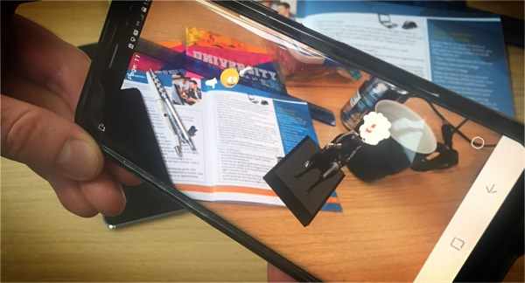
Putting it all together
Oh, the release…!

Slide 84
Putting it all together
If you got here…
There’s your MVP!
It will (almost certainly) have less features than you planned. But
It has shipped.
Be proud!
(get ready to do it again!)

Slide 85
Putting it all together
If you got here…
Take Stock

Slide 86
Putting it all together
If you got here…
Respect your team
Enjoy what you do!

Slide 87
Our highest priority is to satisfy the customer through early and continuous delivery of valuable software.
Welcome changing requirements, even late in development. Agile processes harness change for the customer's competitive advantage.
Deliver working software frequently, from a couple of weeks to a couple of months, with a preference to the shorter timescale.
Business people and developers must work together daily throughout the project.
Build projects around motivated individuals. Give them the environment and support they need, and trust them to get the job done.
The most efficient and effective method of conveying information to and within a development team is face-to-face conversation.
Working software is the primary measure of progress.
Agile processes promote sustainable development. The sponsors, developers, and users should be able to maintain a constant pace indefinitely.
Continuous attention to technical excellence and good design enhances agility.
Simplicity--the art of maximizing the amount of work not done--is essential.
The best architectures, requirements, and designs emerge from self-organizing teams.
At regular intervals, the team reflects on how to become more effective, then tunes and adjusts its behavior accordingly.
From: Principles behind the Agile Manifesto
Image credit: Tory Townsend

